Slide 1

Resume Classification
GROUP - 6

Slide 2
Title: Overview of Resume Classification
Purpose of the Project:
The primary objective of this project is to build a machine learning model that can automatically classify resumes into predefined job roles based on the content. By leveraging Natural Language Processing (NLP) techniques, the model extracts relevant information, such as skills, education, and work experience, to accurately predict the most suitable job category for each resume.
Problem Statement:
Manually screening resumes is a time-consuming and resource-intensive process, particularly for large companies receiving thousands of applications for various positions. Recruiters often face challenges in sorting through vast amounts of information to find the best candidates, leading to delays and inefficiencies. This project solves this problem by automating the resume classification process, ensuring faster, more accurate candidate screening

Slide 3
Importance of Automating Resume Screening: Automating the resume screening process can provide numerous benefits:
Efficiency: Saves recruiters significant time by reducing the need for manual screening.
Consistency: Provides unbiased, standardized classifications, removing human error and subjectivity.
Scalability: Easily handles large volumes of resumes, making it suitable for organizations with high recruitment needs.
Improved Candidate Experience: Speeds up the hiring process, providing timely responses to applicants.
By leveraging AI-driven resume classification, companies can enhance their recruitment workflows, streamline hiring processes, and focus on identifying top talent.

Slide 4
Title: Resume Dataset Overview
Sources of Resume Data:
The resume dataset used in this project consists of resumes in both Word document (.docx) and PDF formats.
These resumes were collected from various professional and public sources to cover a diverse set of candidates and job roles.
The data preprocessing stage involves reading these resumes using Python libraries like pdfplumber and docx to extract text data for further analysis.
Number of Resumes Processed:
A total of 70 + resumes were processed and analyzed during the project.
These resumes cover a wide range of formats, content structures, and levels of detail, providing a robust foundation for building an accurate classification model.
Types of Job Roles Covered:
The dataset is categorized into several job roles, representing diverse fields:
PeoupleSOFT
ReactDev
Sql DEV
Workday resume

Slide 5
Title: Data Preprocessing Techniques
Resume Cleaning and Standardization:
To ensure that the resumes are suitable for machine learning models, a number of data cleaning steps were applied:
Text extraction from Word and PDF files using docx2txt for Word documents and PyPDF2 or pdfplumber for PDFs.
Standardizing text formats, such as converting everything to lowercase to avoid case sensitivity.
Techniques Used:
Tokenization: Splitting the text into individual words or tokens to analyze and process text effectively.
Lemmatization: Reducing words to their base or root form (e.g., "running" to "run") to standardize words that have similar meanings.
Removing Stopwords: Common words like "and," "the," and "is" were removed as they don’t add significant meaning to the classification.
Regular Expressions (re): Used to clean the text by removing unwanted characters, symbols, and numbers.
Libraries Used:
nltk , re , docx2txt , PyPDF2 , pdfplumber

Slide 6
Title: Feature Engineering for Classification
Natural Language Processing (NLP) for Feature Extraction:
NLP techniques were applied to extract meaningful features from resumes, which helped in building robust classification models.
The goal was to identify key information such as skills, job roles, years of experience, and other job-relevant keywords.
Key Feature Extraction Techniques:
Skill Extraction:
Specific domain-related skills (e.g., Python, Machine Learning, Data Analysis) were extracted using keyword matching and pattern recognition.
Libraries such as nltk and spaCy were used to scan resumes for predefined skill sets.

Slide 7
Named Entity Recognition (NER) Models:
NER (Named Entity Recognition) was used to identify and classify key information such as names of organizations, locations, dates, and skills within the resume text.
The en_core_web_lg model from spaCy was employed for advanced text processing and extracting meaningful features.
This model is pre-trained on a large English corpus and can efficiently detect named entities like job titles, companies, and locations.
Advantages of NER and NLP for Resume Classification:
NER helps in accurately recognizing key entities from unstructured text, which is crucial for understanding candidate qualifications.
NLP-based techniques allow for comprehensive feature extraction, resulting in a better understanding of the resumes and improved classification performance.
This step of feature extraction ensures that only the most relevant and informative data is fed into the classification model, increasing the accuracy and reliability of predictions.

Slide 8
Title: Classification Model
Algorithms Used:
The primary classification algorithms used for the project were:
Decision Tree:
A tree-like model where decisions are made by splitting the dataset based on feature values.
Simple and interpretable but prone to overfitting without tuning.
Random Forest:
An ensemble learning method that builds multiple decision trees and averages their results to improve accuracy and reduce overfitting.
More robust than a single decision tree and less likely to overfit.
Support Vector Machine (SVM):
A powerful algorithm used to classify resumes by finding the optimal boundary (hyperplane) between job categories.
Performs well with high-dimensional data and helps in handling outliers.
ETC ….
Accuracy Metrics:
Accuracy: The percentage of resumes correctly classified into their respective job categories.
Precision & Recall: Used to measure how well the model identified relevant resumes for a job category without misclassifications.
F1 Score: A balanced metric combining precision and reca providing insight into the overall performance.
Confusion Matrix: A matrix that provides a detailed breakdown of correct vs. incorrect classifications across job categories.
Model Selection:
The Random Forest algorithm emerged as the best-performing model in terms of accuracy and generalization, thanks to its ability to handle noisy features and avoid overfitting.
This slide highlights the classification models used to automate resume screening, emphasizing their accuracy and optimization through hyperparameter tuning techniques.

Slide 9
Title: Streamlit App Deployment
Model Deployment:
The machine learning model was deployed using Streamlit, a popular framework for building web applications in Python.
Streamlit allows us to transform complex models into an interactive, user-friendly interface for non-technical users.
App Features:
File Uploads:
Users can upload resumes in either PDF or Word Document formats directly through the app.
Once uploaded, the resumes are processed and classified into relevant job categories based on the trained model.
Predictions:
After uploading, the app provides predictions on the job role most suited to the resume.
Users can view the job category, key extracted skills, and any other relevant insights derived from the resume.
Skill Extraction:
The app uses NLP-based feature extraction to identify key skills from resumes.
It highlights skills like SQL , PYTHON , Data science, etc., depending on the job role.
The extracted features are also displayed within the app, making it easier for recruiters to focus on the specific qualifications of the candidate.

Slide 10
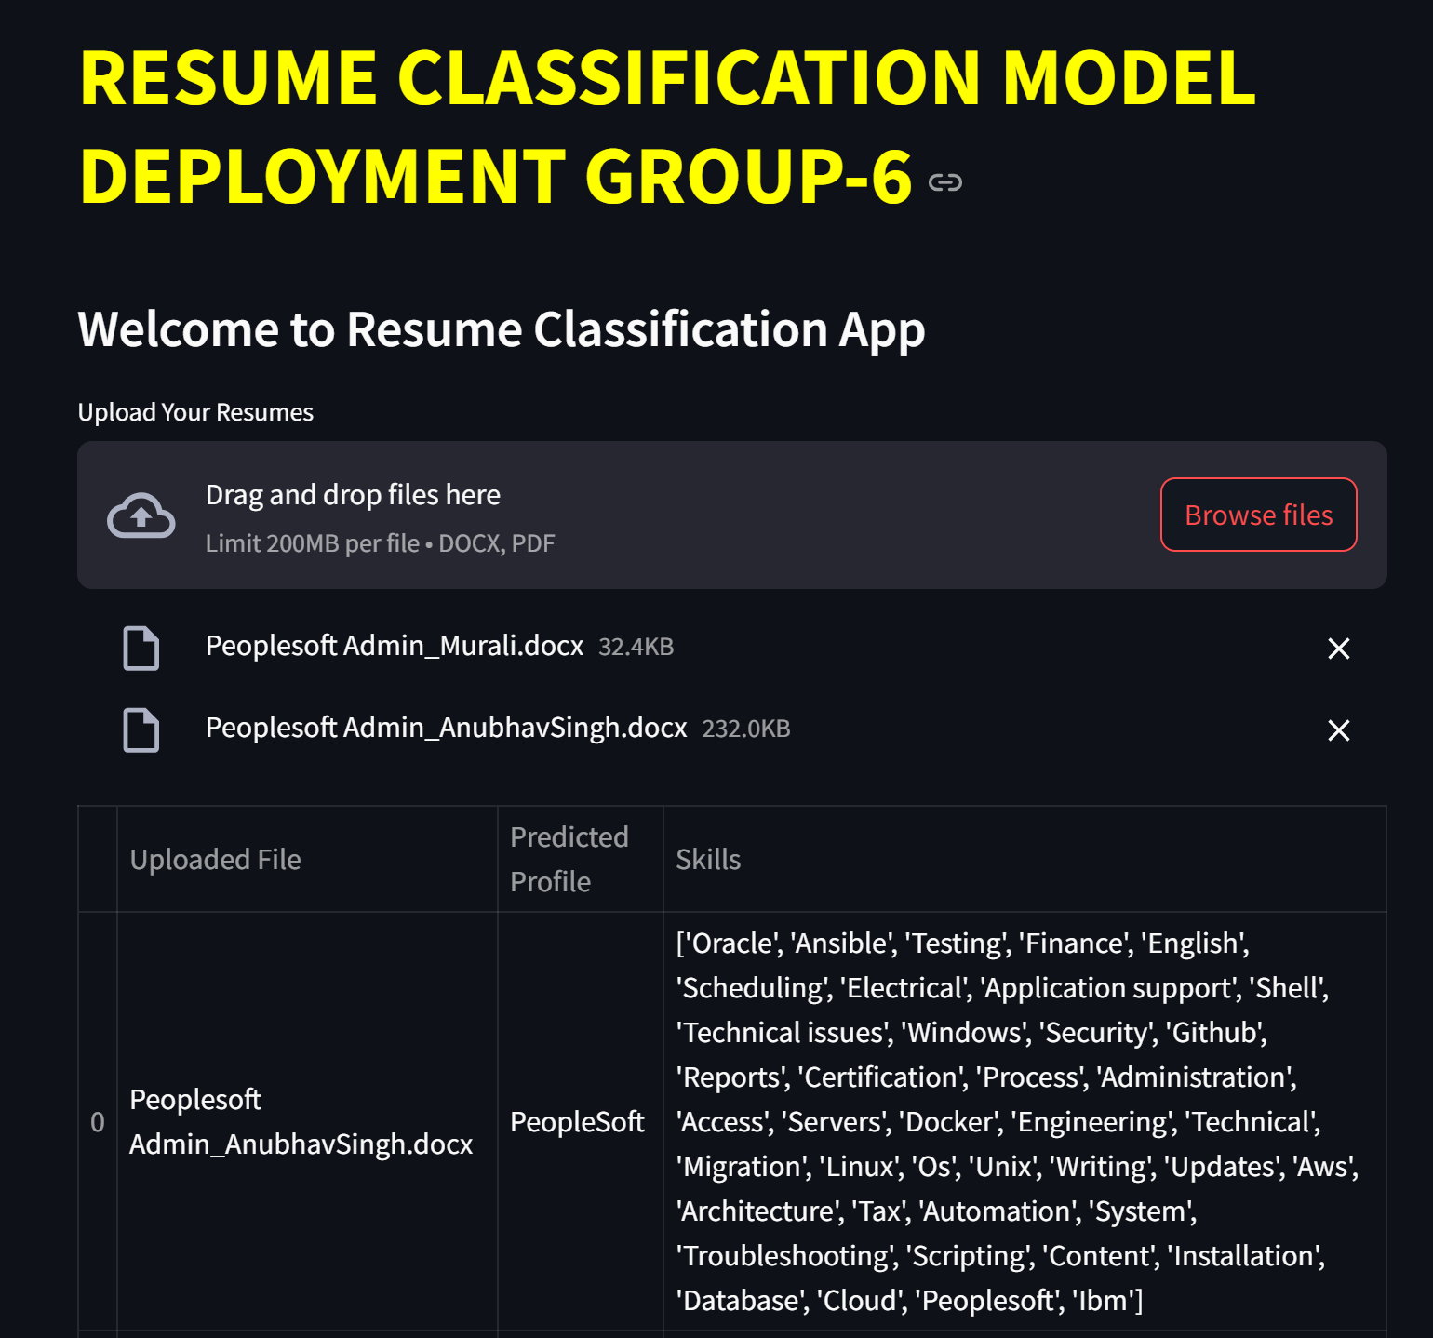
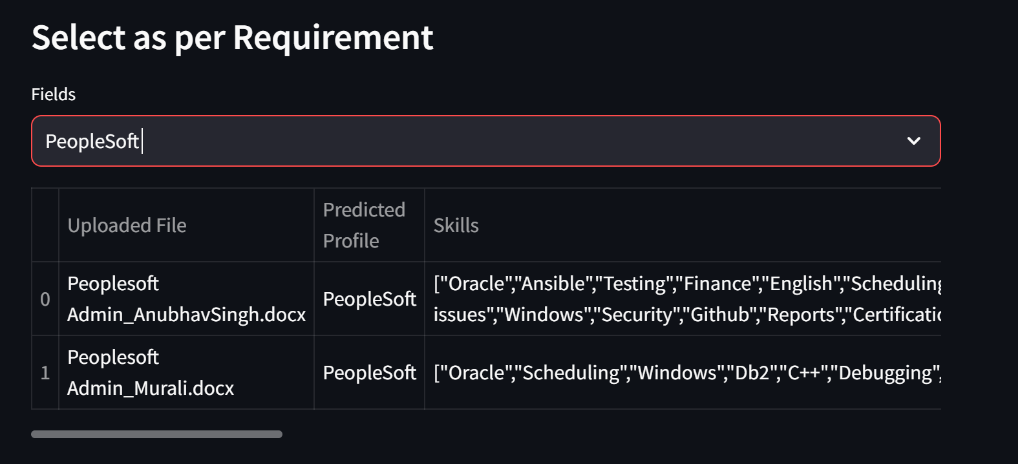
Streamlit web App Interface

Slide 11
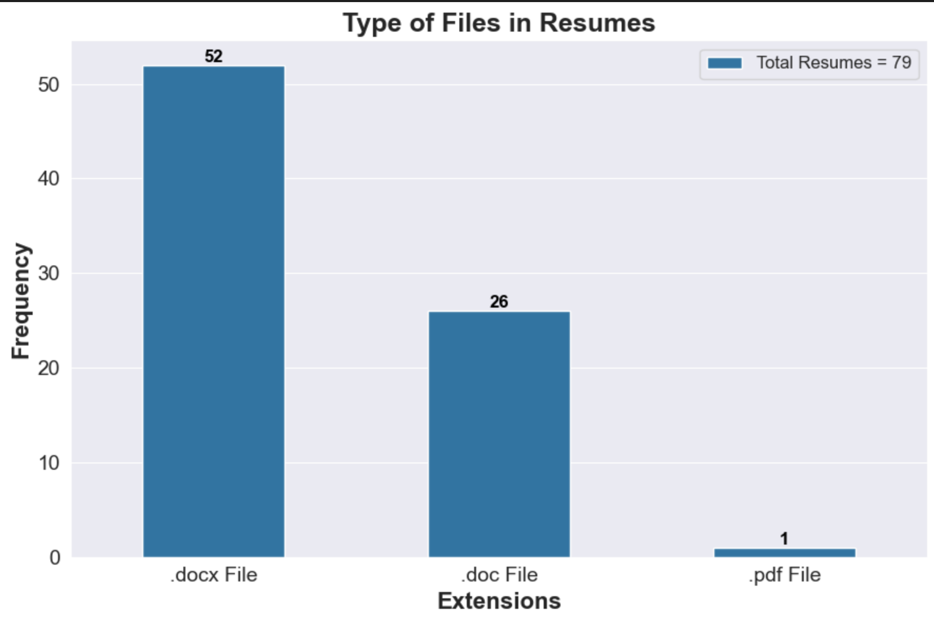
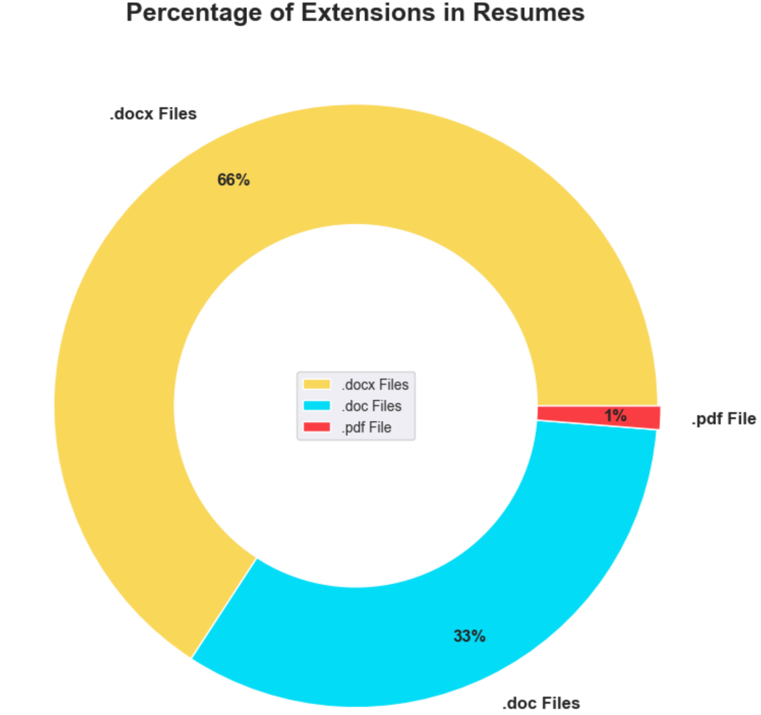
Title: Results of Resume Classification
1:-EDA

Slide 12
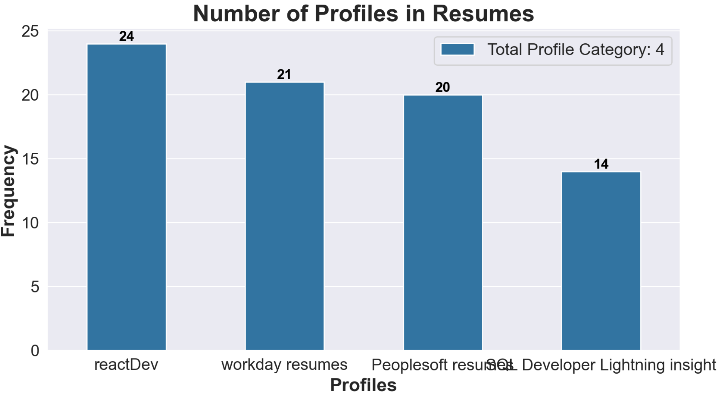
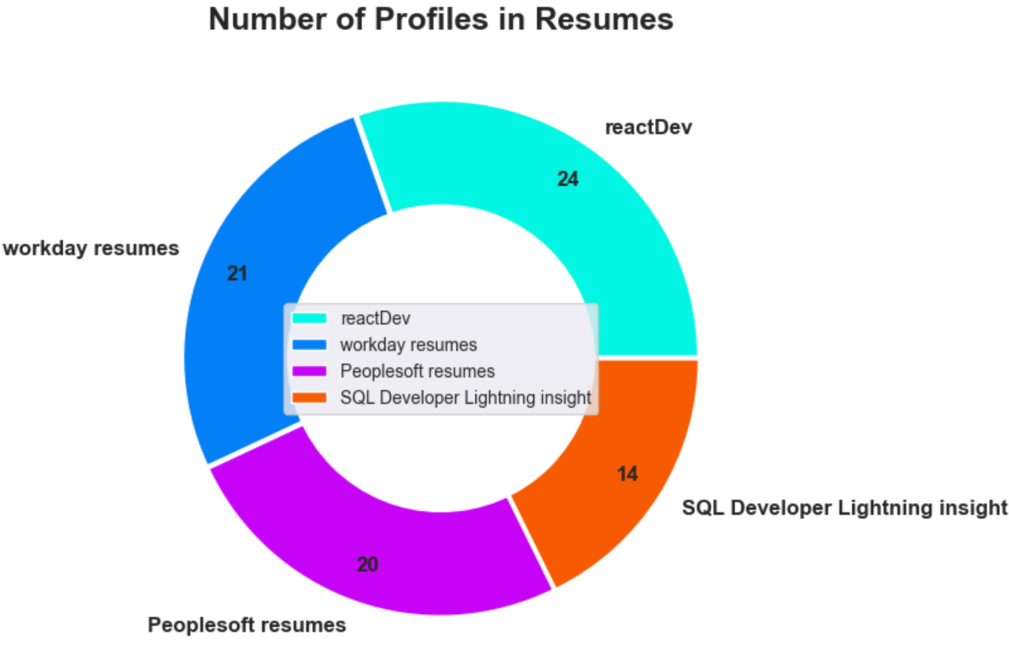

Slide 13
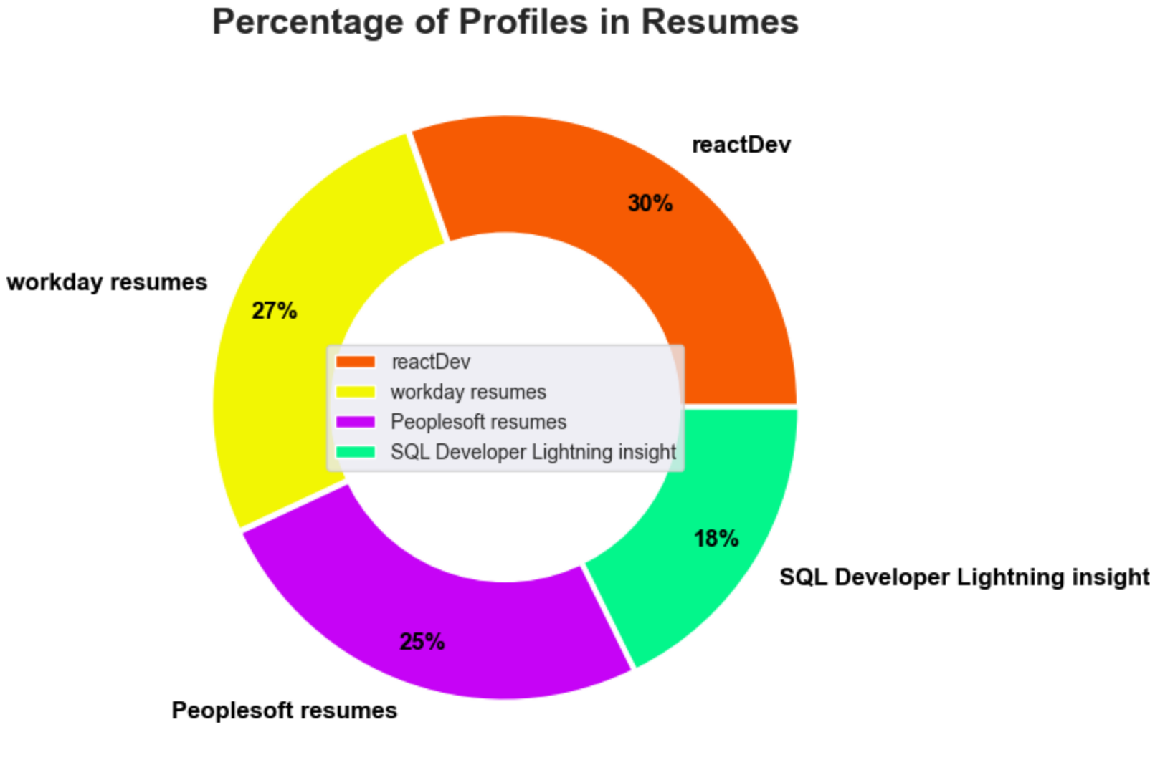
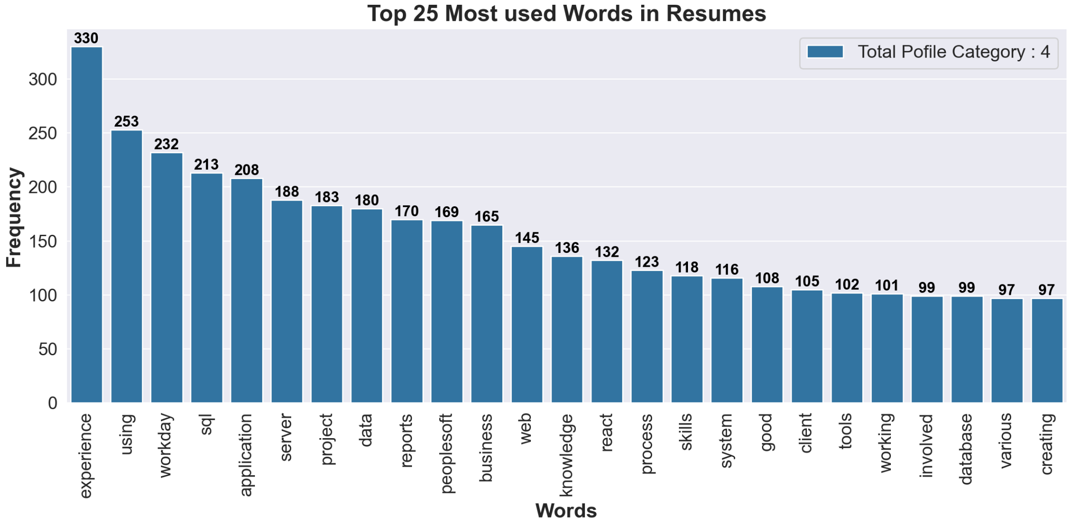

Slide 14
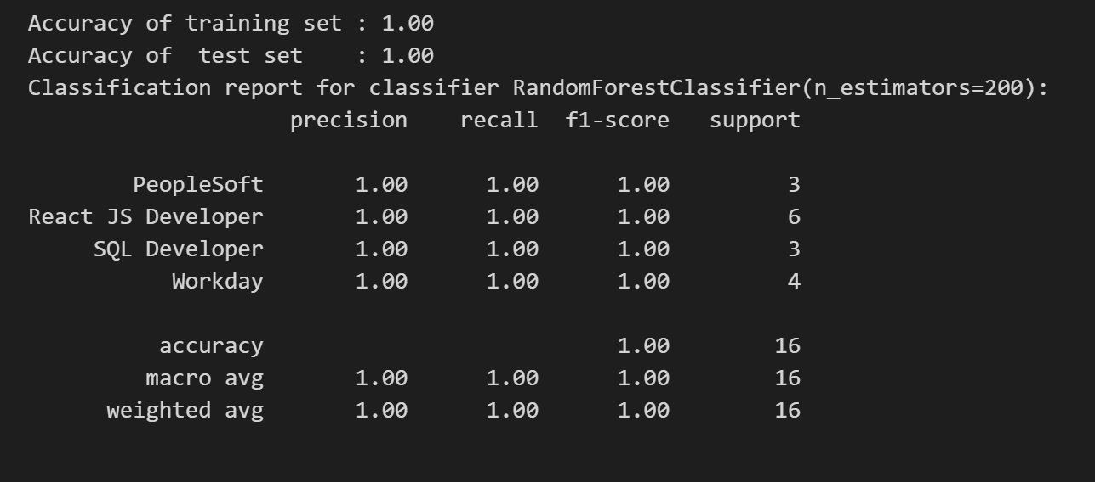
2:- MODEL RESULT
Accuracy and Performance Metrics:
Overall Accuracy: ~ 99%
This indicates that 99% of resumes were correctly classified into their respective job roles.
Precision: 100%
Precision reflects how many of the resumes classified into a specific job role were actually relevant to that role.
Recall: 100%
Recall measures how many relevant resumes were correctly classified for each role.
F1-Score: 100%
The F1-score balances both precision and recall, ensuring that the model is robust across various job roles.

Slide 15
Title: Future Enhancements and Opportunities
Improving Model Accuracy:
Advanced Feature Engineering: Further refining feature extraction by incorporating domain-specific knowledge or using deeper Natural Language Processing (NLP) techniques like BERT or GPT models for more context-aware analysis of resumes.
Handling Diverse Resumes: Improving the model’s ability to handle resumes from diverse industries, job levels, and regions by incorporating more comprehensive training datasets.
2 .Expanding Job Role Categories:
Addition of New Job Roles: Incorporating new job categories to expand the model’s applicability, such as including marketing, operations, finance, and creative roles to cover a wider range of industries.
3 .Scaling for Real-World HR Automation:
Deployment at Scale: Scaling the system to handle larger datasets for real-world HR applications, making it capable of processing thousands of resumes per minute in an enterprise setting.

Slide 16
Title: Summary and Key Takeaways
Project Recap:
The Resume Classification Project successfully demonstrated how AI and machine learning can automate the tedious task of resume screening.
By utilizing NLP and machine learning algorithms like Random Forest, we were able to classify resumes based on job roles and extract key skills automatically.
The project involved multiple steps, including data preprocessing, feature extraction, model training, and deployment using a Streamlit web app.
Key Benefits of AI in Resume Screening:
Efficiency: Automating the resume screening process saves time and effort for recruiters by rapidly identifying suitable candidates.
Accuracy: The use of machine learning ensures that resumes are evaluated consistently, reducing human error and bias.
Scalability: This system can be scaled to process thousands of resumes in minutes, making it highly useful for large recruitment drives.
Thank You:
Conclusion: AI-driven resume classification has the potential to revolutionize how HR departments handle recruitment, streamlining processes and improving hiring efficiency.
Thank you for your attention

Slide 17
|| THANK YOU ||

